Slide 1

GREAT-2 SIV training presentation
GRemubamab ErAdication Trial (GREAT-2)
A phase 2 trial of Gremubamab compared to placebo in participants with bronchiectasis and chronic Pseudomonas aeruginosa infection
GREAT‐2 website https://sites.dundee.ac.uk/great‐2/
CI: Professor James Chalmers, University of Dundee
Trial Management: Tayside Clinical Trials Unit, University of Dundee: great-2-tm@dundee.ac.uk
Sponsor: University of Dundee & NHS Tayside
SIV presentation for GREAT-2 Protocol V4

Slide 2
BACKGROUND
Bronchiectasis is a debilitating chronic respiratory disease characterised by cough, sputum production and associated with a vicious cycle of lung inflammation, and infection.
Approximately one third of people with bronchiectasis become infected with a bacteria called Pseudomonas aeruginosa (P. aeruginosa).
  Often becomes resistant to antibiotics.
  Associated with a 7 fold increased risk of hospitalization and 3 fold increased risk of mortality
The purpose of this trial is to test whether an intravenous infusion containing a new monoclonal antibody called Gremubamab can reduce the amount of infection with P. aeruginosa.
OBJECTIVE
To establish the antipseudomonal activity in-vivo, the optimal dosing and the preliminary clinical efficacy (exacerbations and quality of life) of Gremubamab in patients with bronchiectasis who are chronically infected with P. aeruginosa.

Slide 3
GREMUBAMAB
Monoclonal antibody therapy is a form of immunotherapy that uses monoclonal antibodies to bind specifically to certain cells or proteins.
The objective is that this treatment will stimulate the patient's immune system to attack those cells
Monoclonal antibody therapy is expected to work with the immune system to eliminate P. aeruginosa infection.
New medication being developed by AstraZeneca.
Previous trials:
  Phase I trial (healthy volunteers) well tolerated, infusion reactions being the most common adverse events
  Phase II trial (patients with ventilator associated pneumonia) well tolerated, provided dose guidance for GREAT-2
  Ex-vivo experiments have shown Gremubamab dose dependently increased opsonophagocytic killing of P. aeruginosa by neutrophils from patients with bronchiectasis.
Administered as intravenous infusion 4-weekly

Slide 4
PRIMARY OBJECTIVE
To evaluate the efficacy of Gremubamab on P. aeruginosa bacterial burden in sputum at week 12
Outcome Measure:
Change from baseline to end of treatment in sputum cultures (colony-forming unit)
Timepoint(s)
Baseline and day 84

Slide 5
Secondary Objectives
Objectives | Outcome Measures
To evaluate the efficacy of Gremubamab on P. aeruginosa bacterial burden in sputum | Change from baseline in Quantitative sputum cultures. Days 7, 14, 28 and 56
To determine the persistent effects of Gremubamab on P. aeruginosa bacterial burden following discontinuation of treatment (week 24) | Change from baseline in Quantitative sputum cultures. Day 168
To determine if Gremubamab can achieve eradication of P. aeruginosa in some individuals | Eradication defined by negative sputum cultures for P. aeruginosa at the end of treatment. Days 84 and 168
To determine the effect of Gremubamab on health-related quality of life | Change from baseline in Quality of Life Bronchiectasis questionnaire (QOL-B), Bronchiectasis Impact Measure (BIM) questionnaire. Days 28, 56, 84 and 168
 | Change from baseline in St. George’s Respiratory Questionnaire (SGRQ). Days 84 and 168
To determine the effect of Gremubamab on time to first exacerbation | Occurrence of exacerbations (as per EMBARC definition of exacerbation). First event from visit 1 to day 84
To determine the effect of Gremubamab on pulmonary function | Change from baseline in Forced expiratory volume in 1 second (FEV1). Day 28, 56 and 84
To assess the safety of Gremubamab in patients with bronchiectasis | Frequency of adverse events and serious adverse events between groups. Over 168 days
 | Safety lab parameters. Over 168 days
To evaluate the pharmokinetics of Gremubamab | Gremubamab pharmokinetics parameters through 168 days post dose. Over 168 days
Notes:
Secondary objectives are around additional sputum analysis, quality of life & safety

Slide 6
Exploratory Objectives
Objectives | Outcome Measures
To evaluate immunogenicity of Gremubamab | Gremubumab anti-drug antibody (ADA) response in serum through 168 days post dose
To determine the effect of Gremubamab on sputum colour | Murray sputum colour chart. Days 0, 7, 14, 28, 56 and 84
To determine the effect of Gremubamab on total antibiotic use for exacerbation | Days of antibiotic treatment for exacerbation. Any antibiotic treatment over 84 days (treatment period) and up to day 168 (post-treatment period)
Molecular bacterial load in sputum | Change from baseline in Quantitative polymerase chain reaction for P. aeruginosa. Days 7, 14, 28, 56,84 and 168
Microbiome characterisation- 16s sequencing and ITS sequencing in sputum | Change from baseline in alpha and beta diversity. Days 28, 56, 84 and 168
Neutrophil biomarkers: neutrophil elastase activity in sputum, neutrophil extracellular traps and myeloperoxidase in sputum (NETs) | Change from baseline in biomarker concentrations in sputum . Days 28, 56, 84 and 168
Mucin quantification in sputum (MUC5B and MUC5AC) | Change from baseline in biomarker concentrations in sputum. Days 28, 56, 84 and 168
Sputum proteomics | Change from baseline in sputum proteins. Day 84
P. aeruginosa isolate study* | Whole genome sequencing of P. aeruginosa isolates. All available timepoints where PA is isolated.
To determine the effect of Gremumab on antibiotic resistance* | Testing of P. aeruginosa isolates for susceptibility (minimum inhibitory concentration) to clinically relevant antibiotics. Days 0, 84 and 168
Serum antibodies against P. aeruginosa | Change from baseline in Anti- P. aeruginosa antibodies. Days 84 and 168
Notes:
Exploratory objectives are around further sputum analysis & blood sample analysis

Slide 7
Treatment allocation
Participants will be randomised to one of three treatment arms:
 |  | Dosage, form and strength | Frequency
Arm 1 | Gremubamab | 1500 mg intravenous infusion (reconstituted and diluted to a total volume of 250 mL) | Once every 4 weeks for total of 3 infusions
Arm 2 | Gremubamab | 500 mg intravenous infusion (reconstituted and diluted to a total volume of 250 mL)
Arm 3 | Placebo | Intravenous infusion of 30 mL (as supplied, and diluted to a total volume of 250 mL)

Slide 8
Training:
Identifying Participants, Screening, Eligibility
Visits
Randomisation
Unblinding
Assessments
Concomitant medications
Source data
Lab samples
IMP Prescribing and Administration
Data collection, data entry
Discontinuation, withdrawal, completion
Protocol and GCP Breaches
This presentation is a summary to highlight key points for the SIV
Please view each individual presentation for more details
And record in your individual Trial Training Log (filed in ISF)
Contact the Trial Manager if you have any queries Great-2-TM@dundee.ac.uk

Slide 9
Identifying Participants, Screening, Eligibility

Slide 10
Participant Identification & Pre-screen
Identified from clinic, rehabilitation classes and local databases (where consent is given to receive information about research trials)
Potential participants must have at least 24 hours to consider whether or not to participate after receiving the full PIS before a screening visit is arranged.
Record all participants who are pre-screened on the Screening Log for CONSORT reporting.
  Record: if eligible, or the reason for ineligibility, or if patient declined
  Recruitment Timeline
  Due to IMP expiry dates the first dose of IMP (visit 2) must be completed before end of December 2023

Slide 11
Inclusion Criteria
Age >18 to <86
Clinical diagnosis of Bronchiectasis.
Able to and provided informed consent.
Previous computerised tomography (CT) scan of the chest demonstrating bronchiectasis in 1 or more lobes
P. aeruginosa in sputum, bronchoalveolar lavage or another airway sample at least once in the 24 months prior to screening*.
A sputum sample that is culture or PCR positive for P. aeruginosa sent at the screening visit and within 35 days of randomization* †.
*a participant who does not have a positive sample for P. aeruginosa in the previous 24 months may submit two samples, at least 21 days apart, during the 35-day screening period. If these samples are both positive for P. aeruginosa then inclusion criteria 5 and 6 will be deemed met and the patient may be enrolled.
† repeat sputum samples may be provided during the screening period, if the sample taken during the screening visit is negative for P. aeruginosa.

Slide 12
Exclusion Criteria
Known hypersensitivity to Gremubamab or any excipient of the investigational product
Known clinical diagnosis of Cystic fibrosis
Immunodeficiency requiring replacement immunoglobulin.
Active tuberculosis or nontuberculous mycobacterial infection (currently under treatment or requiring treatment in the opinion of the investigator).
Active allergic bronchopulmonary aspergillosis (receiving treatment with corticosteroids and/or antifungal medication).
Recent significant haemoptysis (a volume requiring clinical intervention, within the previous 4 weeks prior to screening).
Treatment with long term inhaled, systemic or nebulized anti-pseudomonal antibiotics which are newly initiated within the previous 3 months prior to screeningª.
ª Participants who are receiving stable chronic inhaled/nebulized antibiotics with no planned changes to treatment during the trial are eligible. Treatment with systemic macrolide or other oral prophylactic antibiotics are allowed, providing a stable dose, and initiation of treatment at least 3 months prior to screening and maintained throughout the study.

Slide 13
Exclusion Criteria continued
8. Chronic treatment with cyclical doses of inhaled or nebulized antibiotics e.g. 28 days on and 28 days off at the time of screening.
9. Receipt of antipseudomonal antibiotics for an exacerbation during the screening period^{b}.
^{b} Patients receiving antipseudomonal antibiotics during the screening period may prolong the screening period to a maximum of 60 days and may be randomised provided they have a positive sputum sample for P. aeruginosa following cessation of antibiotic therapy. All eligibility criteria must be met prior to randomisation, re-screening procedures to assess eligibility may be required.
10. Treatment with immunosuppressives within previous 6 months prior to screening.
11. Participants with a primary diagnosis of Chronic obstructive pulmonary disease (COPD) associated with >10 pack years smoking history^{c}.
12. Participants with a primary diagnosis of asthma or asthma which is considered to be poorly controlled at screening^{c}.
^{c}Asthma and COPD are common co-diagnoses in patients with bronchiectasis. Where a patient has a diagnosis of bronchiectasis plus either asthma or COPD, they may be enrolled in the trial if the clinician performing the screening assessment determines that bronchiectasis is the primary clinical diagnosis, i.e where the patient’s symptoms and exacerbations are primarily due to bronchiectasis in the opinion of the investigator.

Slide 14
Exclusion Criteria continued
13. Participants with FEV₁ <25% predicted value at screening.
14. Glomerular filtration rate (eGFR) below 25ml/min/1.73m² or requiring dialysis. This will be determined at screening.
15. Use of any investigational drugs within five times of the elimination half-life after the last dose or within 30 days, whichever is longer.
16. Unstable co-morbidities (e.g., cardiovascular disease, active malignancy) which in the opinion of the investigator would make participation in the trial not in the participant’s best interest.
17. Pregnant or lactating females.
18. Women of child baring age or male partners of women of child baring age and not practicing a method of acceptable birth control^{d}
^{d} See protocol section 8.1: Women of child bearing potential (WOCBP) must be willing to have pregnancy testing prior to trial entry and prior to each administration of trial medication dose. In addition, WOCBP must be willing to use a form of a medically approved birth control method throughout the trial (and for minimum of 16 weeks after last dose)

Slide 15
Visits

Slide 16
Type of visit | Screening V1 | Baseline and randomization V2 | Treatment phase V3 | Treatment phase V4 | Treatment phase V5 | Treatment phase V6 | End of Treatment Assessments V7 | Post treatment assessment 1 V8 | Post treatment assessment 2 V9 | Unscheduled visit Assessments
Timeline | -35 days prior to baseline | Day 1 | Day 7 ±2 | Day 14 ±2 | Day 28 ±2 | Day 56 ±2 | Day 84 ±2 | Day 112 ±4 Phone call | Day 168 ±4 | As Required
Informed Consent | X
Inclusion/Exclusion Criteria | X | X
Medical History | X
Physical Examination | X |  |  |  |  |  |  |  |  | X
Record Concomitant Medications | X | X | X | X | X | X | X |  | X | X
Record Adverse Events |  | X | X | X | X | X | X | X | X | X
Height & weight | X
Check Vital Signs | X | X | X | X | X | X | X |  | X | X
ECG | X
Pregnancy Test - serum | X
Pregnancy Test - urine |  | X |  |  | X | X |  |  | X
FBC, U&E, LFT | X |  |  |  | X | X | X |  | X
Research bloods | X | X | X | X | X | X | X |  | X | X
Sputum for P. aeruginosa | X
Research sputum |  | X | X | X | X | X | X |  | X | X
Standard Spirometry | X |  |  |  | X | X | X |  | X
Questionnaires | X | X |  | X | X | X | X |  | X | X
Exacerbation recording |  | X | X | X | X | X | X |  | X
Randomisation |  | X
Trial medication |  | X |  |  | X | X
Vital signs |  | X |  |  | X | X

Slide 17
Visit 1- Screening (approx. 1-2 hours)
Establish participant identity
Informed consent
Medical history including concomitant medication check
Physical examination (doctor)
ECG
Full blood count, urea & electrolytes and liver function tests (local NHS labs)
Serum pregnancy test, if required (local NHS labs)
Research blood samples
Sputum sample for P. aeruginosa testing (local NHS labs)
Spirometry
ECG and all NHS lab results to be reviewed by doctor on Delegation Log
If found to be ineligible, all procedures except blood and sputum sample collection should be completed, if participant agreeable.
Where an ineligible participant’s medical condition or concomitant medications change sufficiently so that they are deemed potentially eligible for the trial, they may be rescreened.
  Must receive a new copy of the PIS, be re-consented and given a new Participant ID number.
Details of all participants consented to the trial to be recorded on the Enrolment and Randomisation Log.

Slide 18
Arranging next visit – timelines (inclusion criteria)
Ensure that the following timelines will be met on the day of visit 2:
A sputum sample that is culture or PCR positive for P. aeruginosa sent at the screening visit and within 35 days of randomization.
P. aeruginosa in sputum, bronchoalveolar lavage or another airway sample at least once in the 24 months prior to screening*
Ensure Glomerular filtration rate (eGFR) below 25ml/min/1.73m² at screening.
Ensure a negative serum pregnancy test at screening for women of childbearing potential.
*Where the participant does not have a record of P. aeruginosa in sputum, bronchoalveolar lavage or another airway sample at least once in the 24 months prior to screening, a sputum sample will be taken for culture at the screening visit, a further sample will be collected at least 21 days after screening. Both of these samples must have evidence of P. aeruginosa growth for eligibility.

Slide 19
Arranging next visit – timelines (exclusion criteria)
Ensure that the following timelines will be met on the day of visit 2:
NO recent significant haemoptysis (a volume requiring clinical intervention, within the previous 4 weeks prior to screening).
NO treatment with long term inhaled, systemic or nebulized anti-pseudomonal antibiotics which are newly initiated within the previous 3 months prior to screening. Participants who are receiving stable chronic inhaled/nebulized antibiotics with no planned changes to treatment during the trial are eligible. Treatment with systemic macrolide or other oral prophylactic antibiotics are allowed, providing a stable dose, and initiation of treatment is at least 3 months prior to screening and maintained throughout the study.
NO chronic treatment with cyclical doses of inhaled or nebulized antibiotics e.g 28 days on and 28 days off at the time of screening. Participants receiving such medications who wish to participate in the trial must agree to discontinue such treatments for the duration of the trial and be 28 days free from antibiotic therapy at the randomization visit
NO receipt of antipseudomonal antibiotics for an exacerbation during the screening period. Patients receiving antipseudomonal antibiotics during the screening period may prolong the screening period to a maximum of 60 days and may be randomized provided they have a positive sputum sample for P. aeruginosa following cessation of antibiotic therapy. All eligibility criteria must be met prior to randomisation, re-screening procedures to assess eligibility may be required.
NO treatment with immunosuppressives within previous 6 months prior to screening.
NO use of any investigational drugs within five times of the elimination half-life after the last trial dose or within 30 days, whichever is longer.

Slide 20
Visit 2 – Day 1, baseline/randomisation, trial medication, 1st dose (approx. 5 – 6 hours)
Up to 35 days after visit 1
Establish participant identity
Inclusion/exclusion criteria check
Adverse event recording
Concomitant medication check
Vital signs
Urine pregnancy test, if required
Exacerbation recording
Eligibility confirmed by delegated doctor
Randomisation
Pre-dose research blood samples
Sputum samples
Pre-dose anti-histamine
Administration of trial medication (240 mins)
Vital signs during administration
Questionnaires
Post-dose observation (30 mins)
Post-dose research blood samples
Participants should be offered refreshments/snack
All NHS lab results must be reviewed by doctor on Delegation Log
Eligibility to be assessed once all blood and sputum results have been reviewed
Assessment of eligibility must be carried out by doctor on Delegation Log
Date of randomisation should be added to the Enrolment and Randomisation Log.

Slide 21
Randomisation

Slide 22
TRuST – Tayside Randomisation System
Web-based randomisation system used by Research Nurses and Clinical Trial Pharmacy Staff
TRuST can be accessed directly: https://hicservices.dundee.ac.uk/TRuST or from the GREAT-2 website https://sites.dundee.ac.uk/great-2/
Trial monitors have access to TRuST to enable them to check randomisation and drug accountability remotely.
Research Nurses will use TRuST for the following :
  Randomisation of participants
  Printing clinical trial release forms
  Record study visits requiring IMP
  Record discontinued study drugs
  Record & re-allocate lost drugs
  Overview of randomisation details
  Overview of drug accountability

Slide 23
Randomisation: Blinding
The GREAT-2 trial requires both blinded & unblinded study team members
If the site team are unable to have both blinded & unblinded team members, the role of randomisation may be delegated to the clinical trial pharmacist team
Please see GREAT-2 site randomisation flow chart for responsibilities for both options
Let the trial manager know who will be performing randomisation at your site
Role | Blinded or Unblinded
Person performing randomisation | Unblinded
Person completing page 1 of clinical trial release form | Unblinded
Trial doctor who signs IMP request form (unless using blinded IMP request form) | Unblinded
Person preparing IMP or placebo IV bag | Unblinded
Person who administers treatment & completes page 2 of Clinical Trial Release Form | Blinded
Person who performs trial assessments | Blinded

Slide 24
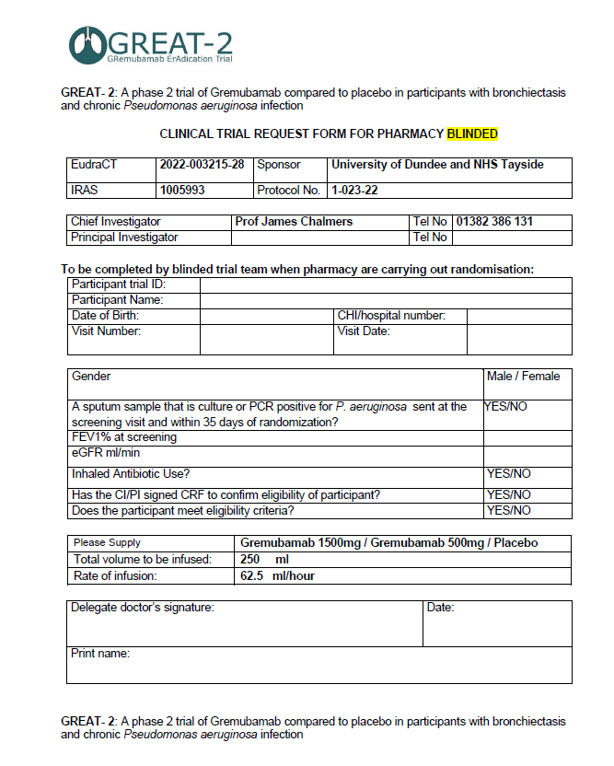
Clinical Trial Request Form – Blinded (Visit 2)
This form is not generated by TRuST
If pharmacy or unblinded team are delegated randomisation then the trial doctor can sign a blinded clinical trial request form if the site does not have an unblinded doctor
Blinded research nurse should complete the participant details & eligibility questions
The trial doctor and research nurse will remain blinded
Take the completed Blinded Request Form to the person who is performing randomisation
The clinical trial request form should be filed in the PSF

Slide 25
Clinical Trial Request Form – Blinded (Visit 5/6)
To request IMP for visit 5 & 6:
Blinded research nurse should complete the participant details
Trial doctor will sign the blinded form to confirm participant can proceed with next dose
Take the completed Blinded Request Form to the person who is performing randomisation
The clinical trial request form should be filed in the PSF

Slide 26
Clinical Trial Release Form for blinded team
Clinical Trial Pharmacy (CTP) or unblinded team members will prepare the IV bag with the IMP or placebo vials, according to the pharmacy manual
When the vials of IMP/Placebo are released from clinical trial pharmacy, TRuST will generate a Clinical Trial Release Form
Important: page 1 of the Clinical Trial Release Form contains unblinded information.
Only page 2 of the clinical trial release form should be given to the blinded team member along with the trial medication infusion.

Slide 27
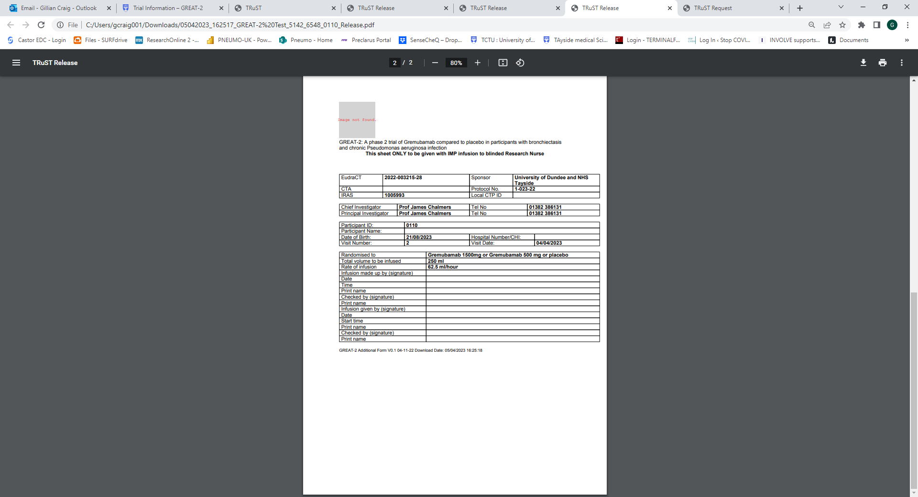
Clinical Trial Release Form – page 2
The blinded nurse giving the infusion to the participant must also sign, date and document the start time of the infusion. This information must be checked & signed by another team member (orange bracket)
After the treatment has been completed, file signed infusion sheet in the ISF
Infusion preparation should be completed as close as possible to the time of treatment administration.
The time between preparation of the dose to administration should not exceed 4 hours at room temperate.
If storage time exceeds this, a new dose must be prepared using new pack IDs and the Trial Manager must be informed.

Slide 28
Randomisation & IMP preparation for sites who have both unblinded research nurses & unblinded doctor
Randomisation is performed by unblinded research nurse
Randomisation
The Unblinded Clinical Trial Request Form is generated from TRuST with randomisation allocation and pack IDs
Clinical Trial Request Form
The Clinical Trial Request Form is generated on TRuST. This must be printed and signed by an unblinded research nurse & unblinded trial doctor
IMP Release
Clinical Trial Pharmacy release pack IDs on TRuST
The Clinical Trial Release Form is generated on TRuST and printed
Page 1 of the Clinical Trial Release Form is signed by CTP staff who released the IMP & the unblinded person collecting the IMP packs for preparation
The unblinded research nurse takes the signed Clinical Trial Request Form to Clinical Trial Pharmacy (CTP)
Pack IDs are released to CTP staff or delegated unblinded team member to prepare IMP infusion
IMP Preparation
CTP or delegated unblinded team member prepare IMP with the IV bags provided
Part of page 2 of Clinical Trial Release Form is completed by the unblinded team member who prepared the infusion
Infusion is labelled with blinded IV bag labels that have been provided, IV bags are covered with coloured sleeves to protect from light
The prepared IV bag & page 2 of the Clinical Trial Release Form are given to blinded research nurse to administer infusion
The last section of page 2 of Clinical Trial Release Form is completed by the blinded person who administered the infusion. This must be filed in ISF.
The signed unblinded Clinical Trial Request Form must be filed in the PSF
Blinded research nurse provides the randomisation details to the unblinded research nurse via an unsigned blinded Clinical Trial Request Form (Visit 2)
Randomisation is performed by unblinded research nurse on TRuST

Slide 29
Randomisation & IMP preparation for sites who have unblinded research nurses but do not have
unblinded doctors
Randomisation is performed by unblinded research nurse
Randomisation
Randomisation is performed by unblinded nurse on TRuST, entering details from the blinded Clinical Trial Request Form
Clinical Trial Request Form
A blinded Clinical Trial Request Form (Visit 2) is completed by blinded research nurse
IMP Release
Clinical Trial Pharmacy release the pack IDs detailed on the unblinded Clinical Trial Request Form
The blinded Clinical Trial Request Form is signed by a blinded research nurse & blinded trial doctor
The blinded Clinical Trial Request Form is provided to the unblinded research nurse
Clinical Trial Request Form (unblinded) is generated from TRuST, this should be printed and filed in PSF alongside the signed blinded Clinical Trial Request Form
IMP Preparation
CTP or delegated unblinded team member prepare IMP infusion
Part of page 2 of Clinical Trial Release Form is completed by the unblinded team member who prepared the infusion
Infusion is labelled with blinded IV bag labels that have been provided, IV bags are covered with coloured sleeves to protect from light
The prepared IV bag & page 2 of the Clinical Trial Release Form are given to blinded research nurse to administer infusion
The last section of page 2 of Clinical Trial Release Form is completed by the blinded person who administered the infusion. This must be filed in ISF.
The unblinded Clinical Trial Request Form does not require to be signed by a doctor as the blinded form has already been signed
The Clinical Trial Release Form is generated on TRuST and printed
Pack IDs & the Clinical Trial Release Form are provided to a delegated unblinded team member to prepare IMP infusion
Page 1 of the Clinical Trial Release Form must be signed by CTP staff who released the IMP & the unblinded team member who will prepare IMP

Slide 30
Randomisation & IMP preparation for sites who do not have unblinded research nurses
Randomisation is performed by clinical trial pharmacy
Randomisation
Randomisation is performed by unblinded CTP staff on TRuST, entering details from the blinded Clinical Trial Request Form
Clinical Trial Request Form
A blinded Clinical Trial Request Form (Visit 2) is completed by blinded research nurse
IMP Release
Clinical Trial Pharmacy release the pack IDs detailed on the unblinded Clinical Trial Request Form
The blinded Clinical Trial Request Form is signed by a blinded research nurse & blinded trial doctor
The blinded Clinical Trial Request Form is provided to Clinical Trial Pharmacy (CTP)
The Clinical Trial Release Form is generated on TRuST and printed
Pack IDs & the Clinical Trial Release Form are provided to a delegated unblinded team member to prepare IMP infusion
Page 1 of the Clinical Trial Release Form must be signed by CTP staff who released the IMP & the unblinded team member who will prepare IMP
Clinical Trial Request Form (unblinded) is generated from TRuST, this should be printed and filed in PSF alongside the signed blinded Clinical Trial Request Form
IMP Preparation
CTP or delegated unblinded team member prepare IMP infusion
Part of page 2 of Clinical Trial Release Form is completed by the unblinded team member who prepared the infusion
Infusion is labelled with blinded IV bag labels that have been provided, IV bags are covered with coloured sleeves to protect from light
The prepared IV bag & page 2 of the Clinical Trial Release Form are given to blinded research nurse to administer infusion
The last section of page 2 of Clinical Trial Release Form is completed by the blinded person who administered the infusion. This must be filed in ISF.
The unblinded Clinical Trial Request Form does not require to be signed by a doctor as the blinded form has already been signed

Slide 31
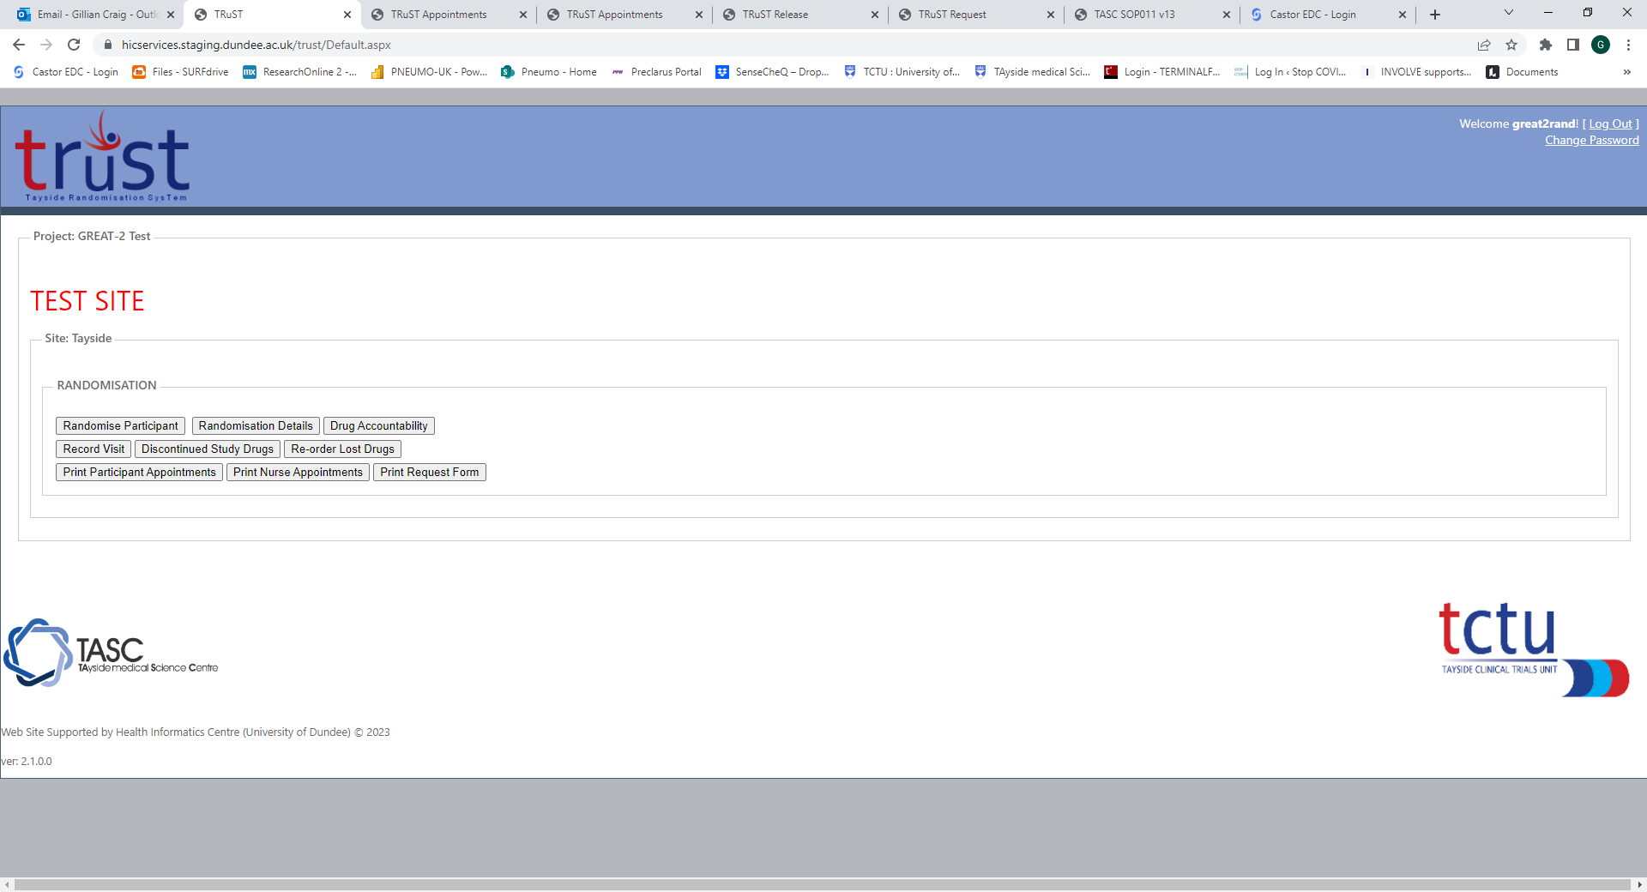
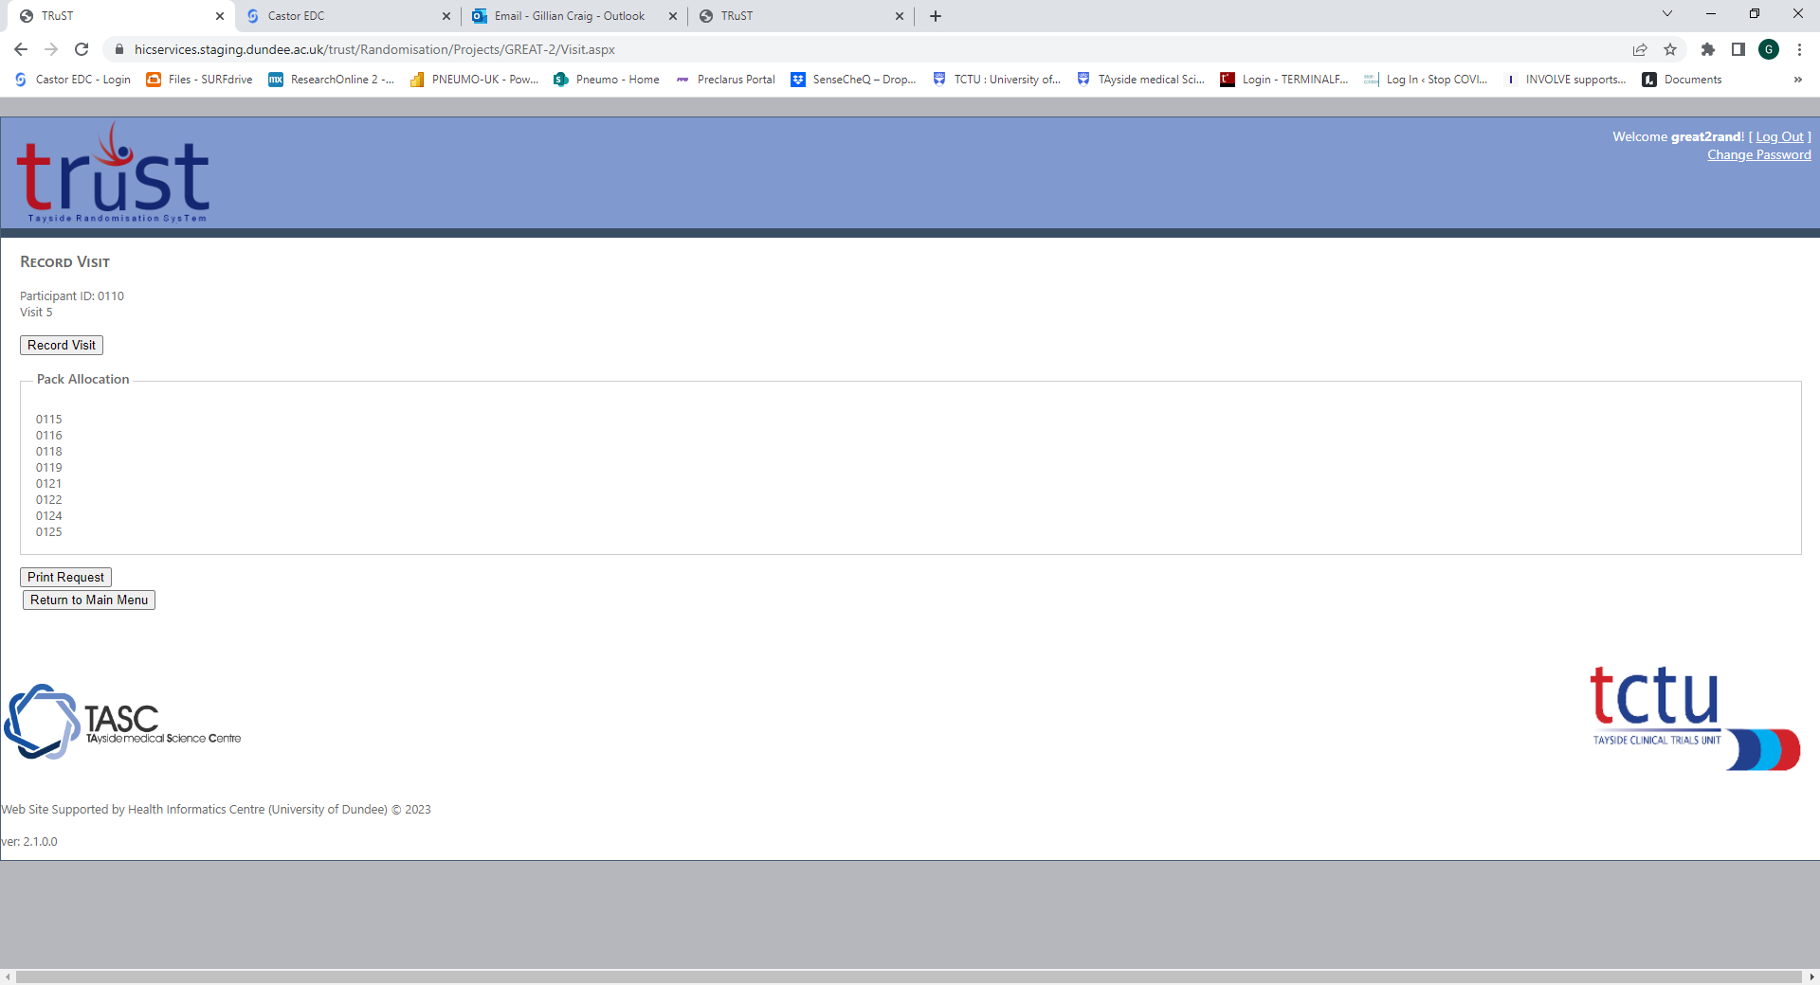
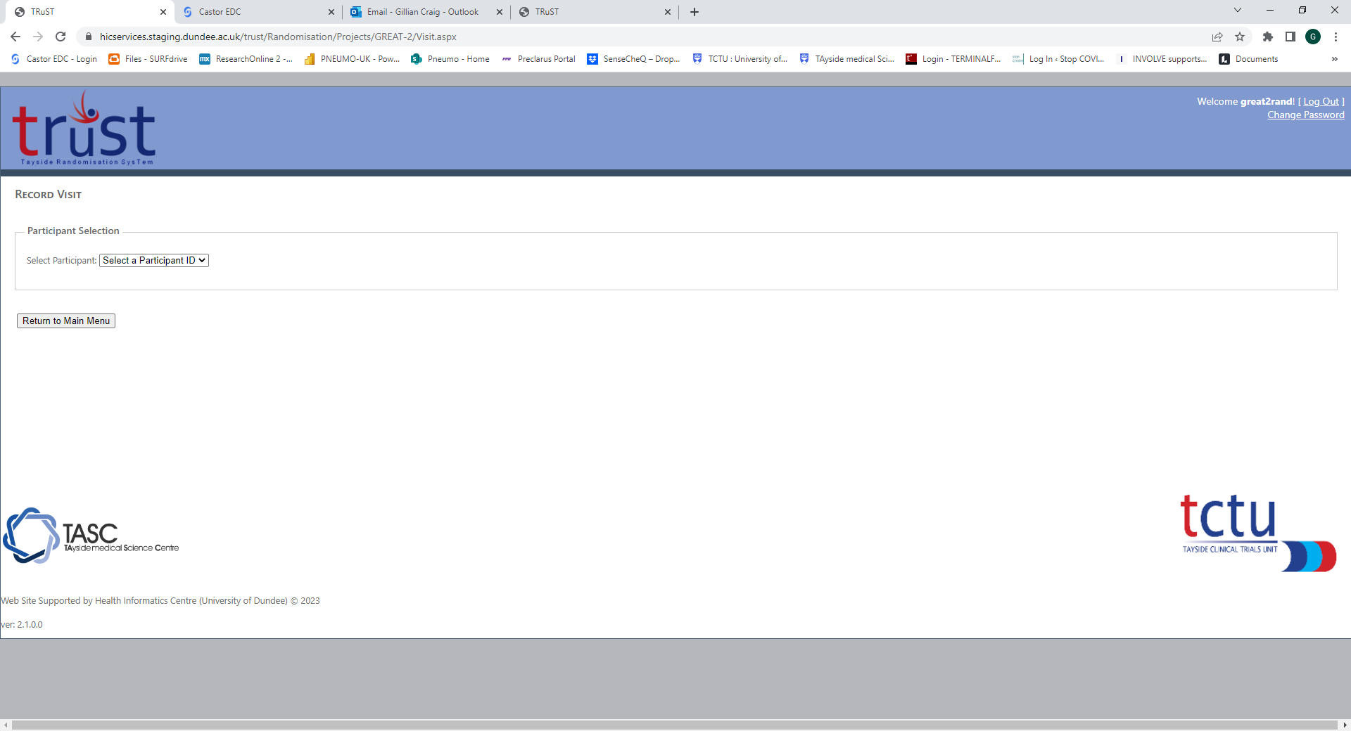
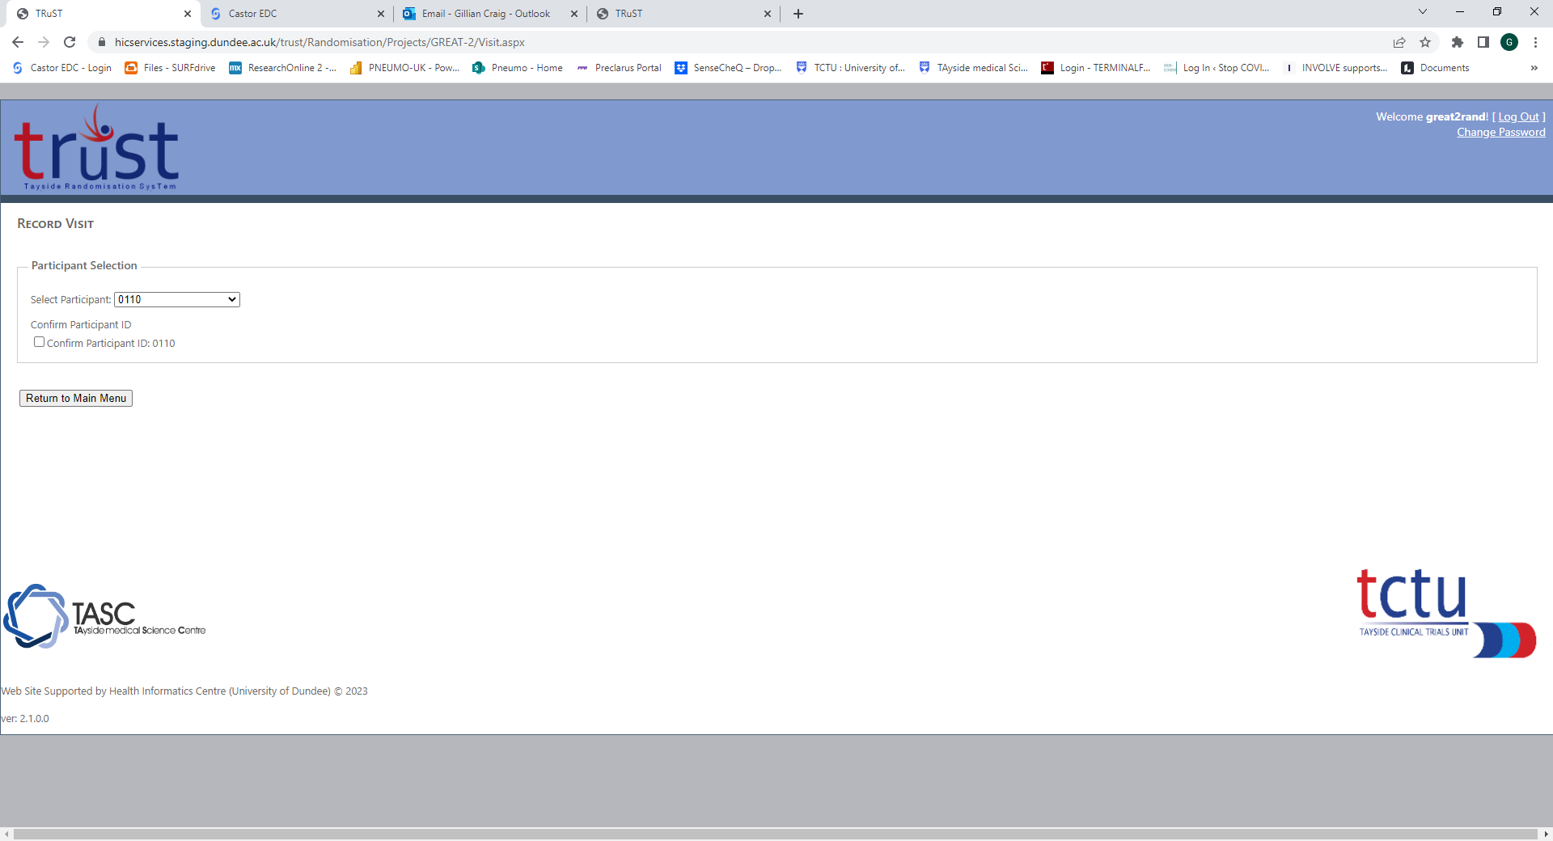
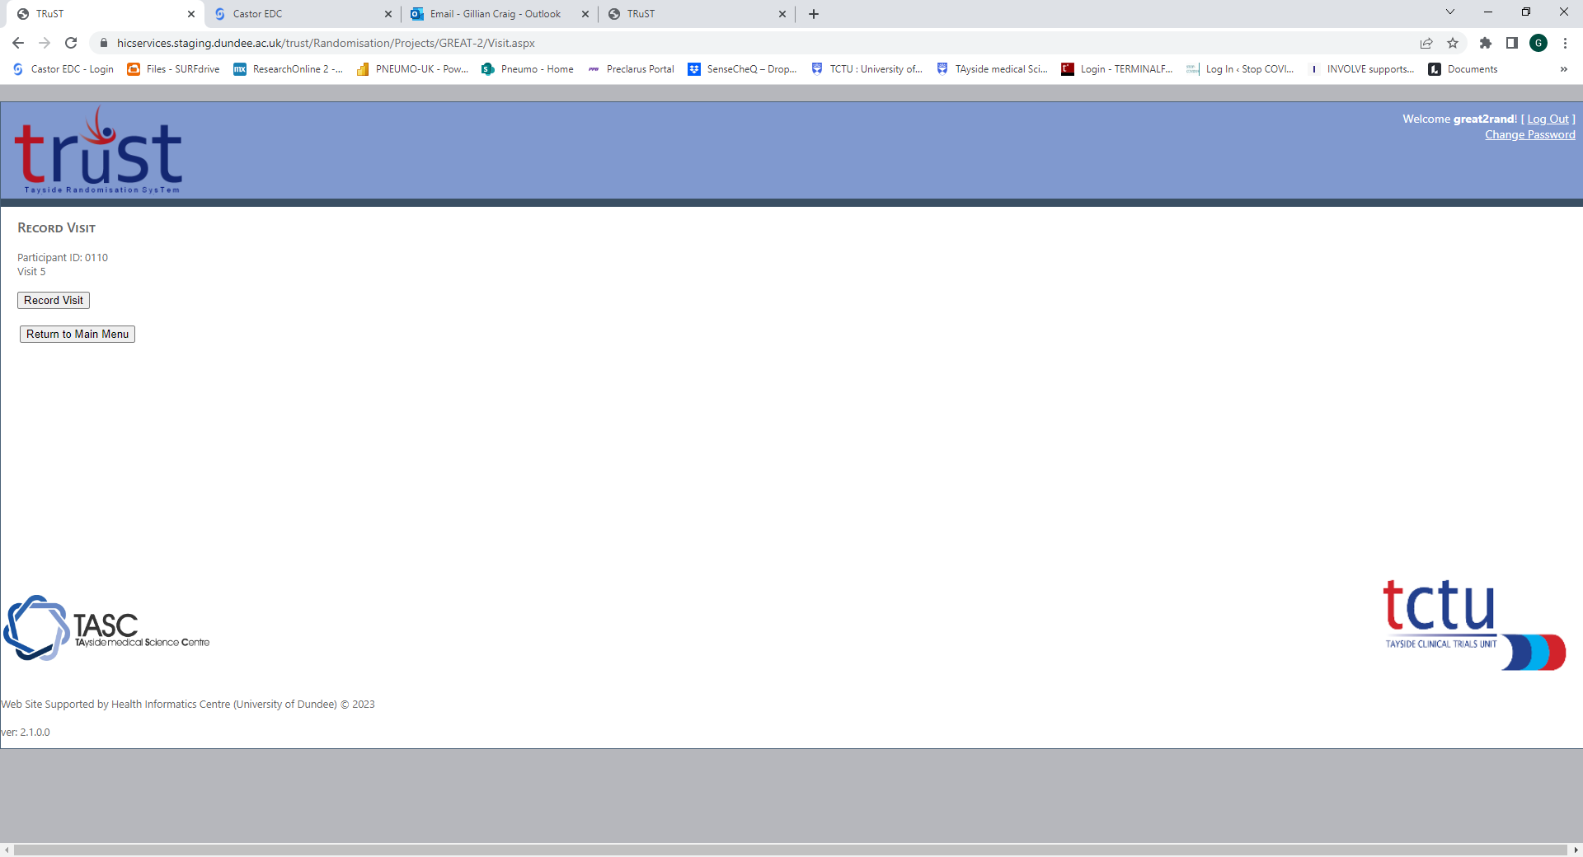
Printing Clinical Trial Request Form for visit 5 & visit 6
From “Main Menu”, click on “Record Visit”
Select participant ID from dropdown list:
Tick “Confirm Participant ID”
Click “Record Visit”
Click “Print Request”, download & print.

Slide 32
TRuST other functions
See GREAT-2 Training Presentation 3 Randomisation
Recording IMP as discontinued
Recording IMP as lost
Allocating replacement packs
Viewing randomisation details
Viewing drug accountability

Slide 33
Emergency Unblinding

Slide 34
Unblinding
Emergency unblinding will be carried out by the PI or delegate.
TRuST access will be provided to the local PI for individual participant unblinding in the event of a medical emergency.
Local Clinical Trial Pharmacy will hold unblinded Clinical Trial Request Forms, unblinding must be carried out in TRuST. TRuST informs Sponsor, CI and TM
Disclosure of the unblinding result should be to individuals involved in the participant’s care only.
PI and those delegated this task must complete 2 dummy unblinding. This must be recorded in Training Log in ISF
See the GREAT-2 Unblinding presentation for details of how to perform unblinding in TRuST

Slide 35
Visits (post-randomisation)

Slide 36
Visit 3 – Day 7 +/- 2 days (approx. 45 min)
Establish participant identity
Adverse event recording
Concomitant medication check
Vital signs
Exacerbation recording
Research blood samples
Sputum samples
Visit 4 – Day 14 +/- 2 days (approx. 45 min)
Establish participant identity
Adverse event recording
Concomitant medication check
Vital signs
Exacerbation recording
Questionnaires
Research blood samples
Sputum samples

Slide 37
Visit 5 – Day 28 +/- 2 days trial medication 2nd dose (approx. 5 – 6 hours)
Visit 6 – Day 56 +/- 2 days trial medication 3rd dose (approx. 5 – 6 hours)
Establish participant identity
Adverse event recording
Concomitant medication check
Vital signs
Exacerbation recording
Urine pregnancy test, if required
Confirmation to receive trial medication by delegated doctor
NHS blood samples
Pre-dose research blood samples
Sputum samples
Spirometry
Pre-dose anti-histamine
Administration of trial medication (240 mins)
Vital signs during administration of trial medication
Questionnaires
Post-dose observation (30 mins)
Post-dose research blood samples
Participants should be offered refreshments/snack

Slide 38
Visit timelines
If a patient is too ill to attend visit 5 or 6 to receive trial medication, the visit may be delayed by up to 7 days
The next visit should be calculated from the delayed visit date.
If a delay of more than 7 days occurs, the scheduled visit should take place but no trial medication will be given. Subsequent visits will take place as originally scheduled.
Missed assessments or missed trial medication will not be reported as breaches when this is due to participant choice or a clinical decision.

Slide 39
Visit 7 – Day 84 +/- 4 days (approx. 45 mins)
Establish participant identity
Adverse event recording
Concomitant medication check
Vital signs
Exacerbation recording
NHS blood samples
Research blood samples
Sputum samples
Spirometry
Questionnaires (including end of treatment questionnaire)
Visit 8 – Day 112 +/- 2 days Telephone call (approx. 10 mins)
Establish participant identity
Adverse event recording

Slide 40
Visit 9 – Day 84 +/- 4 days (approx. 45 mins)
Establish participant identity
Adverse event recording
Concomitant medication check
Vital signs
Exacerbation recording
Urine pregnancy test, if required
NHS blood samples
Research blood samples
Sputum samples
Spirometry
Questionnaires

Slide 41
Unscheduled visits – As required (approx. 45 mins)
Where clinically indicated
Establish participant identity
Adverse event recording
Concomitant medication check
Vital signs
Exacerbation recording
Physical examination (by doctor on Delegation Log)
Urine pregnancy test, if required
NHS blood samples as clinically indicated
Research blood samples
Sputum samples
Questionnaires

Slide 42
Assessments

Slide 43
Demographic details
Ensure participants are 18 years or over and no more than 85 years old on date of randomisation
Smoking Status
A participant’s pack year history should be calculated using the following website:
  www.smokingpackyears.com
Document the figures used for the pack years calculation in the medical notes for source data verification (SDV).
Participants who have a primary diagnosis of COPD and have a pack year history of more than 10 years are not eligible.
History of Bronchiectasis
Participants should have a clinical diagnosis and CT evidence of bronchiectasis in at least one lobe, if not they are not eligible for the trial.
Bronchiectasis Severity Index
Calculated when the answers to the individual questions are entered in the eCRF.
Must be source data in the medical notes to confirm the answers to each of the questions.

Slide 44
Working Practice Guidelines are detailed in the Trial Assessment presentation for:
Height
Weight
Vital signs
ECG
Spirometry
Physical exam
Pregnancy test
Exacerbation recording
Questionnaire completion (self completed on day of visit and then entered on Castor eCRF)

Slide 45
Recording Concomitant Medications

Slide 46
Review of concomitant medications
Taken from medical records and participant reporting
Reported concomitant medications must be recorded in medical records for source data verification
Visit 1
Ask participants to bring their current prescription.
Go through this with them and ensure it is accurate for what the participant is taking at the time of the visit, scoring off medications that the participant is not actively taking on a copy of the prescription.
File a copy of the prescription in the medical notes for SDV.
All other visits
Ask if there are any changes to medication since previous visit.
Record changes in medical notes and eCRF
Excluded Medications
See exclusion criteria
Long-term inhaled or oral anti-pseudomonal antibiotics should not be newly initiated during the study.

Slide 47
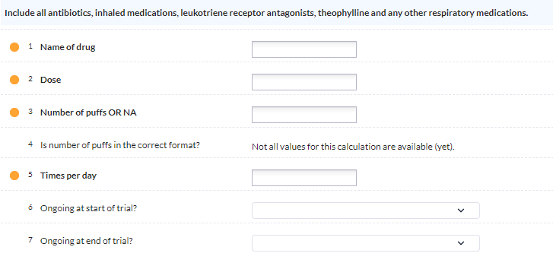
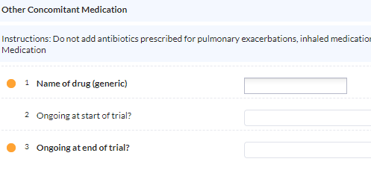
eCRF
There are 2 con med forms
Respiratory & antibiotic con meds: all antibiotics, inhaled medications, leukotriene receptor antagonists, theophylline and any other respiratory medications, brand name - no need to list combined medications separately
Other con meds: less information required, generic name - ingredients of combined medications should be listed separately e.g. for Codydramol list separately as codeine, paracetamol.

Slide 48
eCRF
At visit 1 all medications should be ticked as ongoing at start of trial.
Any new medications during the course of the trial should have a start date.
Any medications stopped should have an end date
At last visit all medications should have either an end date or ticked as ongoing at end of trial

Slide 49
Source Data

Slide 50
Source data
All Visits
All data collected must have back up source data in the participant’s medical record
  Allows for Source Data Verification (SDV)
  Allows other healthcare professionals know about the trial and any assessments completed during visits
Template medical notes continuation sheets are provided and can be used if wished. These should be filed in the medical notes.
If worksheets are used to record source data, they must be filed in the medical record
NB: the worksheets do not cover everything which is required to be recorded in the medical notes.

Slide 51
Source data
All Visits
Date of visit
Confirmation of how participant identity was verified.
Details of any notable findings at the visit and any action taken.
Record of blood, sputum and pregnancy test samples taken.
Copy of blood, sputum and pregnancy test results signed and dated by delegated doctor to be added when obtained.
Changes to con meds (or state there were no changes)
AE’s (or state there were none)
Confirmation that the visit was carried out as per protocol.
Name and Signature of Research staff completing the visit.

Slide 52
Source data
Visit 1
Front coloured card/sheet/sticker to state they are a research participant
Copy of signed Informed Consent Form.
Copy of Participant Information Sheet (PIS) participant has consented to.
Copy of GP letter informing GP of participation
Confirmation that the participant has had the PIS for at least 24 hours
Eligibility Confirmation Form
Must be completed before randomisation
Must be dated and signed by doctor on Delegation Log
Must be filed in the medical record

Slide 53
Source data
Assessments
History of bronchiectasis details, if source data not elsewhere in medical notes.
Medical & smoking history if not elsewhere in medical notes.
Height and weight
For women who were deemed not WOCBP document how this was confirmed.
Physical exam normal/abnormal and action taken if appropriate.
Evidence for questions asked for Bronchiectasis Severity Index, if not elsewhere in medical notes.
Copy of ECG signed and dated by doctor on Delegation Log. Result of ECG i.e. normal/abnormal and any action taken if appropriate.
Vital signs (as recorded in eCRF).
Vital signs taken during trial medication administration.
Spirometry results and how bronchodilation was achieved.

Slide 54
Lab samples

Slide 55
Blood samples
Blood samples should be obtained as per Laboratory Manual.
NHS samples:
  Results should be reviewed by a doctor on the Delegation Log in a timely manner.
  A copy of the results signed and dated by a delegated doctor must be filed in the participant’s medical notes.
Research samples:
  Processed as per Laboratory Manual
  Stored at site and transferred to core labs University of Dundee at end of trial.
Pregnancy Test
Visit 1
Blood should be sent to local NHS lab for a serum pregnancy test.
All other visits
Urine pregnancy test should be carried out
A copy of the results signed and dated by a delegated doctor should be filed in the participant’s medical notes.

Slide 56

Sputum samples
Sputum samples should be obtained as per Laboratory Manual.
Visit 1 NHS sputum sample: results should be reviewed by a doctor on the delegation log and a signed and dated copy filed in the participant’s medical notes.
Research Sputum Samples (all other visits)
Transferred to core lab, Queens University Belfast, on day of collection
All visits and sputum sample shipments should take place Monday – Thursday
Samples will be shipped next day delivery using DHL medical express
See GREAT-2 Sputum Sample Shipment Process & GREAT-2 Sputum Shipment Requirements documents for more details
Chilled packaging for sputum samples will be provided
+5°C and -20°C cool packs must be chilled at least 72 hours prior to the shipment
Human sputum samples are considered category B dangerous goods
Each sputum shipment must be labelled with the category B sticker provided

Slide 57
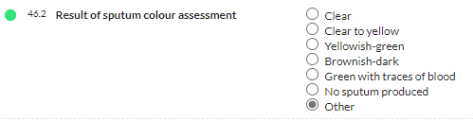
Sputum samples
Participants will be asked to produce a spontaneous sputum sample at each visit.
A hierarchical approach to obtaining sputum samples will be used:
  spontaneous sputum sample produced at the visit
  spontaneous early morning sputum brought from home on the day
  spontaneous early morning sputum brought in within 48 hours of the scheduled visit.
  Induced sputum in sites able to perform induced sputum according to local protocols.
Sputum colour will be assessed using the Murray Sputum Colour Chart, see eCRF.
Research sputum samples must be transferred to core lab, Queens University Belfast, on day of collection.

Slide 58
Sputum Sample Shipments
Each shipment must contain:
1 sputum sample placed in the inner packaging box
Ensure sputum sample is secured by packing with an absorbent material (e.g. paper towel) to prevent movement
Surround inner box with cool packs (as shown in diagram)
Ensure category B label is placed on the outer packaging
Box must contain a printed sputum sample log & completed sputum shipment document
Must also email the sample log & shipment document to:
Trial Manager: great-2-tm@dundee.ac.uk
Belfast lab: Chloe.McLaughlin@qub.ac.uk
For more details refer to: GREAT-2 Lab Manual

Slide 59
Research Blood Samples
See the lab manual for the blood samples & volumes to be collected at each visit and the sample processing required.
PK blood samples
PK samples (SST tubes) should be collected from the opposite arm to the infusion.
The pre-dose samples should be taken within 1 hour of the start of infusion.
Post infusion samples should be taken between 10 minutes and 1 hour after the end of infusion.
All times of sample collection and start/end of infusion should be recorded.

Slide 60
Sample Processing

Slide 61
Sample Labelling
All study samples should be labelled with labels provided
Each sample label must be completed with the sample ID and date of collection
Sample ID is made up of:
site number – participant number – visit number – sample number
e.g. sample ID 01-01-02-01 would be site 01 – participant 01- visit 02- sample number 01
Blood samples should be stored in separate boxes according to sample type.
Storage boxes should be labelled with trial title, site number, sample type and box number.
Sample type, date of collection and storage location should be recorded on the GREAT-2 Sample Log.
GREAT-2 Whole Blood
Sample ID: _ _ - _ _ - _ _ - _ _
Date: _ _ - _ _ - _ _ _ _

Slide 62
IMP/Placebo Prescribing and Administration

Slide 63
Antihistamine
IV antihistamine should be administered prior to the Gremubamab/placebo infusion following local procedures.
For example, 10 mg chlorpheniramine IV, 50 mg diphenhydramine IV, clemastine 2 mg IV, or dexchlorpheniramine 5 mg IV (or another antihistamine preparation utilised in routine clinical practice for management of acute allergic reactions).
Where a participant is already taking antihistamines then the pre-dose antihistamine should not be given.
Antihistamine should be prescribed and dispensed by local pharmacy as per local practice.
A record of the administration of the antihistamine must be documented in the participant’s medical notes

Slide 64
IMP/Placebo Administration
IV infusion over 4 hours – 62.5 ml/hour or slower
The duration of the infusion must not exceed 8 hours.
An IV infusion pump must be used
All participants in all 3 dose arms must receive the entire 250 mL volume of Gremubamab/placebo IV unless the infusion is discontinued due to an AE.
A low protein binding 0.2 μm or 0.22 μm filter must be used
Must never be administered via IV push or bolus.
IV tubing should be primed with Gremubamab/placebo from the infusion bag before initiating infusion.
On completion, IV tubing should be flushed with 0.9% normal saline via infusion pump at the same rate as dosing.
The start time of the infusion will be the time the infusion of the Gremubamab/placebo solution from the infusion bag (with IV tubing already primed with Gremubamab/placebo solution) is started.
The stop time of the infusion should be the time the IV tubing has been flushed to administer the residual Gremubamab/placebo solution.

Slide 65
Safety Monitoring
BP, P, Temp & O₂ sats, recorded before infusion and at 5, 30, 60, 120 and 240 mins after the start of the infusion and 30 minutes after end of infusion.
  Record in medical record
  Not entered in eCRF
Site must have drugs/equipment to treat acute anaphylactic reactions plus staff trained to recognise and treat anaphylaxis.
Allergic reaction grade: Assessed using Common Terminology Criteria for Adverse Events
  Grade 1 Mild; asymptomatic or mild symptoms; clinical or diagnostic observations only; intervention not indicated.
  Grade 2 Moderate; minimal, local or non-invasive intervention indicated; limiting age appropriate instrumental activities of daily living.
  Grade 3 Severe or medically significant but not immediately life-threatening; hospitalization or prolongation of hospitalization indicated; disabling; limiting self care activities of daily living.
  Grade 4 Life-threatening consequences; urgent intervention indicated.
  Grade 5 Death related to AE.

Slide 66
Treatment of Allergic Reaction
Non-severe allergic reaction (grade 1 or 2) as determined by the local PI (or delegate);
  Reduce infusion rate
  Initiate treatment as appropriate
  Continuation of further doses of Gremubamab/placebo will be decided by the PI in discussion with the participant.
  Complete adverse event form
Allergic reaction ≥ grade 3, including anaphylaxis, assessed as related to the trial:
  Stop infusion immediately
  Initiate treatment as appropriate
  Withdrawn from further Gremubamab/placebo treatments.
  Complete adverse event form

Slide 67
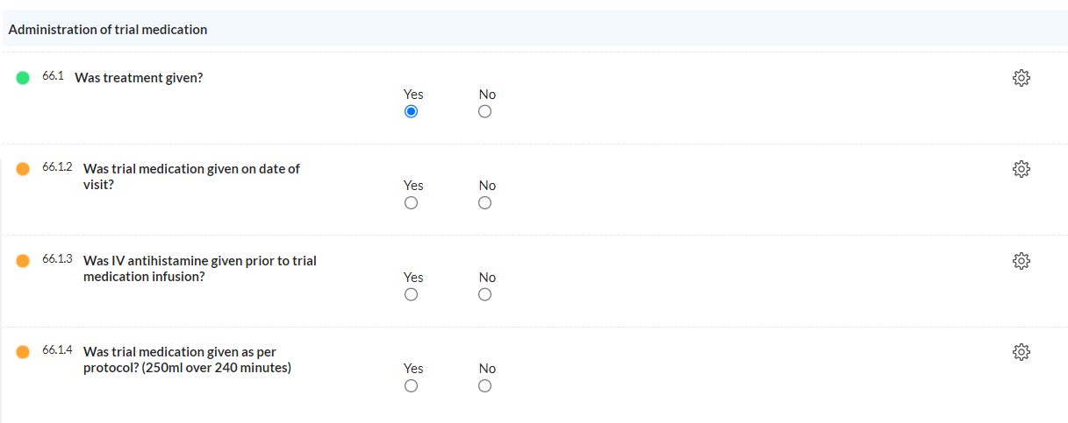
Documenting infusion administration
Details of the infusion administration must be entered in the participant’s medical notes
Also recorded in eCRF

Slide 68
Data Collection & Data Entry

Slide 69
Castor eCRF
Data entry is performed in the electronic case report form (eCRF) using the Castor Electronic Data Capture system
This can be accessed here: https://uk.castoredc.com/
It is a secure, hosted system that is GCP-compliant

Slide 70
Castor training
Inform the Data Manager which site team members need access to Castor
Access to a test site will be provided
Castor training will be provided by the Data Management Team
Castor training consists of:
  Brief data training sheet to enter test data & become familiar with Castor
  Supported by a data entry guideline document
  PI data verification guidelines
  Additional one-to-one training if required
Access to the live system will be given when training is completed and the person is delegated this task on the Delegation Log
The Data Management Team can be contacted on: Great-2-DM@dundee.ac.uk

Slide 71
Paper worksheets
Sites will be provided with a paper worksheet for all visits.
Concomitant Medication Log & AE Log are separate worksheets. These should be reviewed at each visit.
The use of worksheets is optional. Worksheets will not be monitored and should not be archived at the end of the trial. If used to record source data they must be filed in the medical notes.
Sites will also be provided with a continuation sheet, to record source data for each visit. Use of this is optional but if not used the information must be documented in the medical records.
Questionnaires – ensure the correct questionnaires are completed at each visit.

Slide 72
Recording Discontinuation, Withdrawal or Completion of Trial

Slide 73
Discontinuation of trial medication
Trial medication will be discontinued in the following circumstances:
  Pregnancy (a pregnancy notification form must be completed)
  Allergic reaction ≥ grade 3, including anaphylaxis, assessed as related to the trial drug
Allergic reaction grade: Assessed using Common Terminology Criteria for Adverse Events
  Grade 1 Mild; asymptomatic or mild symptoms; clinical or diagnostic observations only; intervention not indicated.
  Grade 2 Moderate; minimal, local or non-invasive intervention indicated; limiting age appropriate instrumental activities of daily living.
  Grade 3 Severe or medically significant but not immediately life-threatening; hospitalization or prolongation of hospitalization indicated; disabling; limiting self care activities of daily living.
  Grade 4 Life-threatening consequences; urgent intervention indicated.
  Grade 5 Death related to AE.
73

Slide 74
Discontinuation of trial medication – continuation of trial visits
If a participant has been randomised, and given one or more dose of IMP, they should be asked to complete trial visits as per the protocol, to allow for an intention to treat analysis
Participants are free to refuse to do so.
The Investigator may discontinue a participant’s trial medication at any time, if it is in the best interest of the participant and treatment continuation would be detrimental to the participant’s wellbeing.
The Investigator will make a clinical judgment as to whether or not an adverse event (AE) is of sufficient severity to require discontinuation of a participant’s trial medication .
A participant may also voluntarily discontinue trial medication due to what he or she perceives as an intolerable AE.
If a participant discontinues trial medication but remains on the study, a Discontinuation of Trial Medication Form should be completed on the eCRF (Repeating Data Form)
Record on TRuST that participant has Discontinued Study Drugs
74

Slide 75
Withdrawal from trial – stops all trial activity
Participants are free to withdraw at any time and are not obliged to give reason(s).
Discuss with the participant the value to the trial of discontinuing trial medication but continuing with trial follow up rather than withdrawing completely.
Make a reasonable effort to ascertain the reason(s), both for those who express their right to withdraw and for those lost to follow up, while fully respecting the individual’s rights.
The participant should be offered an end-of-trial assessment.
If a participant withdraws and does not remain on the study, the Completion of Trial/Early Withdrawal visit should be completed on the eCRF.
75

Slide 76
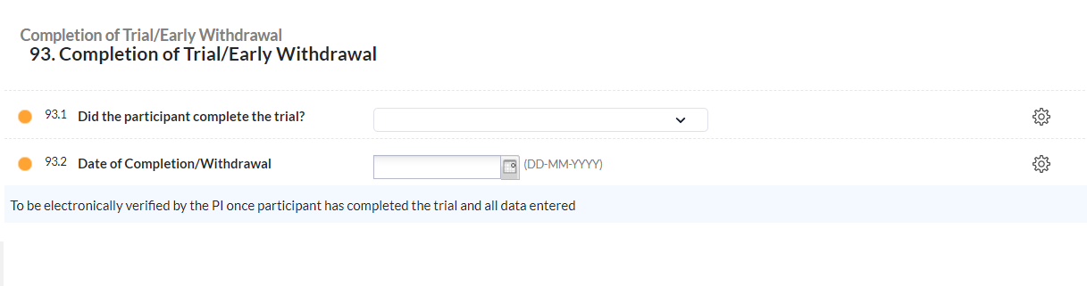
Completion of Trial
Once a participant has completed all trial visits, the Completion of Trial/Early Withdrawal Visit must be completed
76

Slide 77
Breach Reporting

Slide 78
What is a breach?
Any departure from:
  Approved Protocol
  Conditions of approvals
  Principles of GCP
  Written procedures (SOPs)
  Regulatory requirements
  Insurance cover
  Contractual obligations
  Confidentiality and GDPR
Our Sponsor does not recognise deviations – all deviations should be classified as breaches and reported.

Slide 79
Breach reporting
Breach reporting is the responsibility of the site team
Breach reporting is made directly to the Sponsor
Online breach reporting form must be downloaded from TASC website to ensure you are using correct version. The form can be found under TASC SOP59:
https://www.dundee.ac.uk/tasc/policies-sops-templates/study-progress
Email copy of breach report form to tascpotentialbreach@dundee.ac.uk & copy in GREAT-2-TM@dundee.ac.uk
Every breach must be documented on the Breach Log in the site file
Corrective And Preventive Action (CAPA)
Corrective
What did you do to fix it?
Preventive
Preventive action is to stop the problem from happening again or to stop other sites doing the same
What can you do to stop it happening again?

Slide 80
Are breaches always serious?
    No.
The majority are technical breaches that do not result in harm to the trial participants or significantly affect the scientific value of the reported results
But…several non-serious breaches can become one Serious Breach as collectively they do have a detrimental impact
Therefore ALL must be reported to Sponsor & to great-2-tm@dundee.ac.uk and documented on the Breach Log
If you are unsure, report anyway

Slide 81
Documents required for site activation:
Delegation Log
Training Logs
IMP received at site
Lab packs received at site
Access to TRuST for delegated team members for randomisation
Access to TRuST for IMP release (pharmacy)
PI trained & have access to unblinding on TRuST
At least one team member trained and have access to Castor
At least PI trained & have login details for the PV database

Slide 82
GRemubamab ErAdication Trial (GREAT-2)
A phase 2 trial of Gremubamab compared to placebo in participants with bronchiectasis and chronic Pseudomonas aeruginosa infection
GREAT‐2 website https://sites.dundee.ac.uk/great‐2/
CI: Professor James Chalmers, University of Dundee
Trial Management: Tayside Clinical Trials Unit, University of Dundee: great-2-tm@dundee.ac.uk
Sponsor: University of Dundee & NHS Tayside

