Slide 1
IMP Management
V3 22-10-20
1

Slide 2
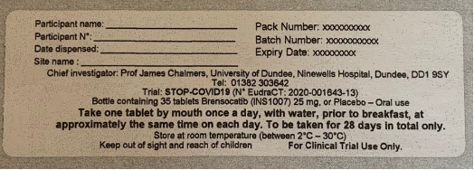
IMP
Brensocatib (INS 1007) or Placebo
Supplied by Insmed
25mg tablets supplied in bottles of 35 tablets, clinical trial label
Notes:
IMP for this trial is

Slide 3
Dosing
Once daily for 28 days
Before breakfast
Administer with water
Missed dose:
give within 10 hours, record as late dosing
if over 10 hours wait for next dose, record as missed.
If naso-gastric tube: crush, dissolve in water, use syringe to push through tubs, flush with 10mL water, clamp for 30 mins then release.
If discharged from hospital, remaining IMP taken home

Slide 4
IMP Supply
Initial supply to site will be 10 bottles
Sharp Clinical Services will supply IMP to Clinical Trial Pharmacy (CTP)
QP Release Certificate and an Acknowledgement of Receipt with each shipment:
Acknowledgement of Receipt emailed to Sharp Clinical Services SCSUK-ShipmentRequests@sharpclinical.com & Trial Manager stop-covid19@dundee.ac.uk
QP Release Certificate & Acknowledgement of Receipt should be filed in the Pharmacy Site File (PSF)
TCTU Trial Manager (TM)will manage stock:
If stock levels are causing concern, CTP should contact the TM.
Notes:
CTP at each site
Each shipment will be accompanied by a
To confirm delivery …

Slide 5
IMP Storage
Stored securely between 2°C and 30°C
Daily temperature log whilst in pharmacy:
Retained for audit
PSF file note to detail location of log.
Quarantine IMP if exposed to temperatures below 2°C or above 30°C:
Clinical Trial Pharmacy report to the TM
Site should provide the TM with temperature logs from the preceding 4 weeks
Quarantined IMP must be clearly marked as in quarantine & stored separately
In discussion with Insmed and the Sponsor, TM will identify what action is necessary.

Slide 6
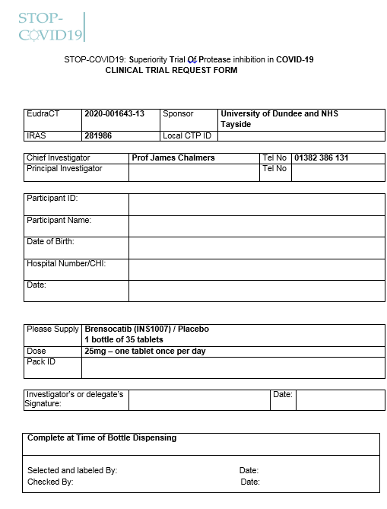
Post-Randomisation IMP Release 1
At point of randomisation TRuST (Tayside Randomisation System) will generate a pack ID:
This information will be emailed to Clinical Trial Pharmacy
RN take printed copy of the TRuST allocation email & STOP-COVID19 request form to Clinical Trial Pharmacy.
The STOP-COVID19 Clinical Trial Request Form will be filed in the PSF
Notes:
i.E the day it is to be delivered to the ward
if they are moved to a different ward

Slide 7
Post-Randomisation IMP Release 2
Clinical Trial Pharmacy/delegated staff will verify that the pack ID on the bottle issued matches the number on the Request form.
At time of release Clinical Trial Pharmacy/delegated staff adds to the IMP bottle :
participant name
participant number
site name
date of dispensing
Where possible check for contra-indicated medications: Itraconazole, Ketoconazole, diltiazem, verapamil, phenytoin or rifampicin, HIV treatments - current treatment with protease/integrase inhibitors or non-nucleoside reverse transcriptase inhibitors. (The Liverpool HIV checker (https://www.hiv-druginteractions.org/checker) should be used to check for any HIV drug interactions. Simvastatin could be used as a surrogate for Brensocatib as it metabolised similarly by CYP 3A4 pathway.)

Slide 8
IMP Handling (1)
IMP should be prescribed on drug chart/equivalent as per local practice
Highlight on electronic/paper drug chart that participant should not receive excluded drugs
Where possible IMP should be stored in individual patient drug lockers
Speak to as many to the ward staff as possible and highlight the requirements of the trial
Ensure ward staff are aware of the importance of giving IMP from the correct bottle
Check drug charts when reviewing participants to see if they are getting IMP every day before breakfast
Where handover sheets are used in the ward add that the patient is on the STOP-COVID19 trial to ensure all ward nurse are aware
Notes:
i.E the day it is to be delivered to the ward
if they are moved to a different ward

Slide 9
IMP Handling (2)
Liaise closely with ward staff when participants move ward or to/from ICU to ensure IMP goes with the participant and the new ward is aware of requirements.
Liaise closely with ward staff when participants are due to be discharged to ensure participants receive their IMP to take home
When phoning participants after discharge check that they have STOP-COVID19 IMP. Some participants have thought that other discharge drugs e.g. dexamethasone are the trial IMP.
Notes:
i.E the day it is to be delivered to the ward
if they are moved to a different ward

Slide 10
IMP Returns
Participants discharged from hospital will be provided with the remainder of the IMP and instructions to complete 28 days treatment:
Participants will be given a stamped addressed envelope to post back returns.
Diary details instructions for participants
Returns should be handled as per local infection control policy
IMP returned to Clinical Trial Pharmacy should be counted and entered on Accountability Log.
IMP will be disposed of following local disposal policy and recorded on Disposal Form. This does not require further approval from Sponsor.
A copy of the local disposal/destruction policy should be filed in the PSF (or file note to location).

Slide 11
Emergency unblinding
Unblinding is only carried out where necessary for clinical safety:
If required, the clinician should contact the local PI or delegate
PI or delegate will perform unblinding:
Log-in to access 24-hour TRuST unblinding
Complete & sign an unblinding form
PI is responsible for ensuring that anyone delegated to this role has sufficient training & instructions
Clinician will decide whether participant remains on IMP.
Emergency unblinding training slide set provides details.
Notes:
a physician considers that it is
To permit unblinding in the event of a medical emergency
Where possible to participant will remain in the trial and continue trial procedures

Slide 12
Emergency recall
May be initiated by Sponsor, Insmed or Sharp Clinical Services
Clinical Trial Pharmacies, Principal Investigators, Research Team Staff and the Chief Investigator will be alerted by email detailing required action:
For CTP stock, for example IMP disposal, quarantine or return
For participants in possession of the recalled IMP.

