Slide 1
Emergency unblinding procedure

Slide 2
Introduction
Unblinding for the STOP-COVID19 trial will be carried out using the web-based Tayside Randomisation System (TRuST)
Unblinding can be carried out by the PI or other research staff listed on the delegation log
Any person delegated to carry out emergency unblinding must have completed training, including a test unblinding

Slide 3
TRuST System
TRuST can be accessed directly: https://hicservices.dundee.ac.uk/TRuST or from the STOP-COVID19 website http://www.stop-covid19.org.uk
Trust Unblinding User Guide is located in the ISF
Login details for emergency unblinding are detailed on the Emergency Unblinding Procedure document, located in the ISF, section 9

Slide 4
Unblinding procedure
Login with the username and password found in the Emergency Unblinding Procedure document in section 9 of the ISF
When prompted, enter your name

Slide 5
Unblinding procedure
Main menu.
Click emergency unblinding.

Slide 6
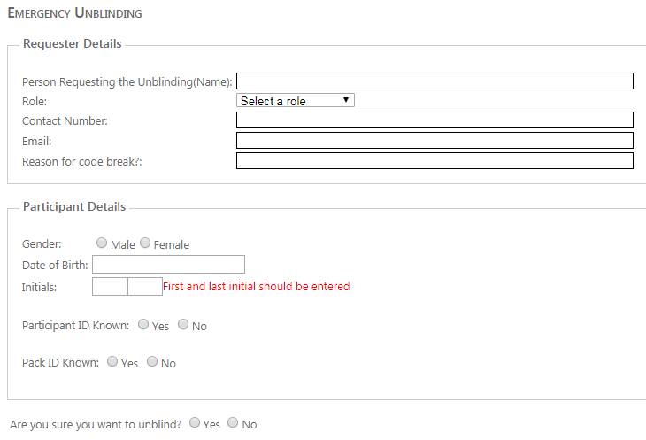
Unblinding procedure
Details of person requesting unblinding
Enter
participant details
participant ID if known (dropdown menu)
pack ID if known

Slide 7
Unblinding procedure
Select yes if you are sure you have the correct details and wish to unblind.
Unblind participant button appears
Click unblind participant

Slide 8
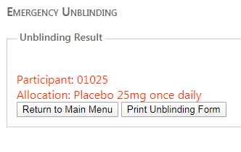
Unblinding procedure
The unblinding result will be displayed.
If no match found, or more than one match found, ‘unable to match unless patient ID or bottle number known’ will be displayed
Select print unblinding form

Slide 9
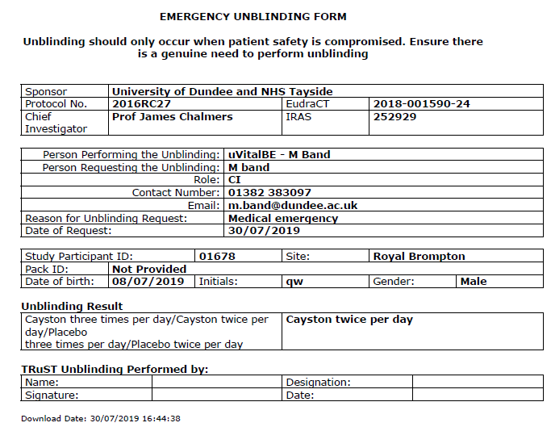
Unblinding procedure
Emergency unblinding form will be generated
Check details are correct
Print form
Complete “Performed by” section at end
Place in sealed envelope labelled with participant’s ID number and “Emergency unblinding details – do not open unless information required for clinical purposes”.
File in ISF section 9.2.

Slide 10
Unblinding procedure
If participant ID and pack ID are not available, unblinding can be performed using participant identifiers: gender, date of birth and initials
If it is not possible to print unblinding form immediately the form will be available on TRuST for 24 hours and MUST be completed in that time
If internet access is possible but TRuST is inaccessible please contact the Clinical Trial Manager or Chief Investigator during working hours. Out of working hours please contact the NHS Tayside on-call pharmacist
Clinical Trial Manager: stop-covid19@dundee.ac.uk
Chief Investigator, Professor James Chalmers: 0774 0124 122 j.chalmers@dundee.ac.uk
NHS Tayside On-call Pharmacist 01382 660111 ask for On-call Pharmacist

