Slide 1
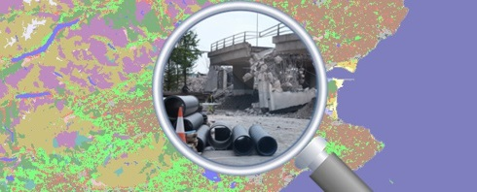
Uncovering the Environment: The Use of Public Access to Environmental Information
Professor Colin Reid
Dr Sean Whittaker
Society of Legal Scholars Annual Conference
3 September 2019

Slide 2
Legal Framework
Aarhus Convention
EU Directive 2003/4/EC
Environmental Information (Scotland) Regulations 2004

Slide 3
Right of Access to Environmental Information
Primary aims of the right
Promoting public participation
Transparency and accountability
Are these aims achieved in practice?
“Misuse of the legislation”

Slide 4
Project Methodology
Qualitative analysis of requests
Dialogue with Scottish Information Commissioner, SEPA and SNH
Surveys and interviews with members of the public and public authorities

Slide 5
Emerging Findings – Users
Motives for using the right
Are they environmental in nature?
A singular motivation?
An abuse of the system?
Participative aims of the right v. self-interest of the users

Slide 6
Broader Questions – Use of the Right in Practice
Do non-environmental motives lead to negative uses of environmental information?
Users see limited opportunities to participate in and influence the decisions of Scottish public authorities

Slide 7
Emerging Findings – Proactive Disclosure
The use of proactively disclosed environmental information
Increased accessibility through technology
The right is viewed (wrongly) as predominantly request-driven

Slide 8
Broader Questions- Conceptualisation of the Right
Do “users” view themselves as “users”?
Interactions between proactive disclosure and disclosure on request
The shape of academic research

Slide 9
Conclusion
https://sites.dundee.ac.uk/envinfo/
s.x.whittaker@dundee.ac.uk
Project Team: Professor Colin Reid ESRC: ES/P010067/1
Dr Jonathan Mendel
Dr Sean Whittaker

